Slide 1


HaiLv
2024/08/15

Slide 2

Outline
Executive Summary
Introduction
Methodology
Results
Conclusion
Appendix

Slide 3
Executive Summary
Summary of methodologies
Data Collection through API
Data Collection with Web Scraping
Data Wrangling
Exploratory Data Analysis with SQL
Exploratory Data Analysis with Data Visualization
Interactive Visual Analytics with Folium
Machine Learning Prediction
Summary of all results
Exploratory Data Analysis result
Interactive analytics in screenshots
Predictive Analytics result

Slide 4
Introduction
Project background and context
SpaceX advertises Falcon 9 rocket launches on its website with a cost of 62 million dollars; other providers cost upward of 165 million dollars each, much of the savings is because Space X can reuse the first stage. Therefore, if we can determine if the first stage will land, we can determine the cost of a launch. This information can be used if an alternate company wants to bid against SpaceX for a rocket launch. This goal of the project is to create a machine learning pipeline to predict if the first stage will land successfully.
Problems you want to find answers
What factors determine if the rocket will land successfully?
The interaction amongst various features that determine the success rate of a successful landing.
What operating conditions needs to be in place to ensure a successful landing program.

Slide 5

Section 1

Slide 6
Methodology
Executive Summary
Data collection methodology:
Data from SpaceX was obtained from 2 sources:
SpaceX API(https://api.spacexdata.com/v4/rockets/)
Web Scraping (https://en.wikipedia.org/wiki/List_of_Falcon/_9/_and_Falcon_Heavy_l aunches)
Perform data wrangling
Collected data was enriched by creating a landing outcome label based on outcome data after summarizing and analyzing features

Slide 7
Methodology
Executive Summary
Perform exploratory data analysis (EDA) using visualization and SQL
Perform interactive visual analytics using Folium and Plotly Dash
Perform predictive analysis using classification models
Data that was collected until this step were normalized, divided in training and test data sets and evaluated by four different classification models, being the accuracy of each model evaluated using different combinations of parameters

Slide 8
Data Collection
Describe how data sets were collected.
Datasets were collected from SpaceX API (https://api.spacexdata.com/v4/rockets/) and from Wikipedia (https://en.wikipedia.org/wiki/List_of_Falcon/_9/_and_Falcon_Heavy_launches), using web scraping techniques

Slide 9
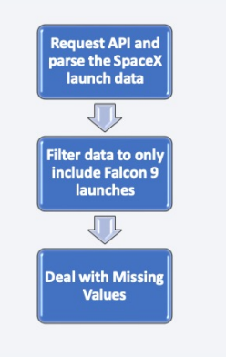
Data Collection – SpaceX API
SpaceX offers a public API from where data can be obtained and then used;
This API was used according to the flowchart beside and then data is persisted.
Source: https://github.com/Lucky-Lee-029/DataScience/blob/main/jupyter-labs-spacex-data-collection-api.ipynb

Slide 10
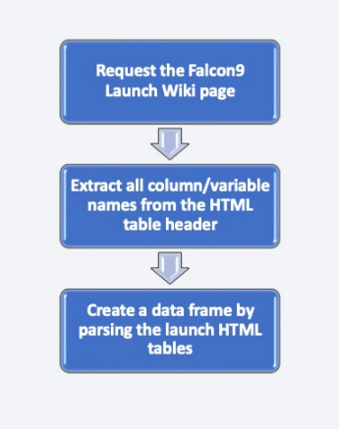
Data Collection - Scraping
Data from SpaceX launches can also be obtained from Wikipedia;
Data are downloaded from Wikipedia according to the flowchart and then persisted.
Source: https://github.com/Lucky-Lee-029/DataScience/blob/main/jupyter-labs-webscraping.ipynb

Slide 11
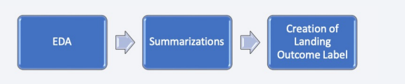
Data Wrangling
Initially some Exploratory Data Analysis (EDA) was performed on the dataset.
Then the summary launches per site, occurrences of each orbit and occurrences of mission outcome per orbit type were calculated.
Finally, the landing outcome label was created from Outcome column.
Source: https://github.com/Lucky-Lee-029/DataScience/blob/main/labs-jupyter-spacex-Data%20wrangling.ipynb

Slide 12
EDA with Data Visualization
The following SQL queries were performed:
Names of the unique launch sites in the space mission;
Top 5 launch sites whose name begins with the string 'CCA’;
Total payload mass carried by boosters launched by NASA (CRS);
Average payload mass carried by booster version F9 v1.1;
Date when the first successful landing outcome in ground pad was achieved;
Names of the boosters which have success in drone ship and have payload mass between 4000 and 6000 kg;
Total number of successful and failure mission outcomes;
Names of the booster versions which have carried the maximum payload mass;
Failed landing out comes in droneship, their booster versions, and launch site names for in year 2015;
Rank of the count of landing outcomes (such as Failure (droneship) or Success (ground pad)) between the date 2010-06-04 and 2017-03-20.
Source: https://github.com/Lucky-Lee-029/DataScience/blob/main/edadataviz.ipynb

Slide 13
EDA with SQL
To explore data, scatterplots and bar plots were used to visualize the relationship between pair of features:
Payload Mass X Flight Number, Launch Site X Flight Number, Launch Site X Payload Mass, Orbit and Flight Number, Payload and Orbit
Source: https://github.com/Lucky-Lee-029/DataScience/blob/main/jupyter-labs-eda-sql-coursera_sqllite.ipynb

Slide 14
Build an Interactive Map with Folium
Markers, circles, lines and marker clusters were used with Folium Maps
Markers indicate points like launch sites;
Circles indicate highlighted areas around specific coordinates, like NASA Johnson Space Center;
Marker clusters indicates groups of events in each coordinate, like launches in a launch site; and
Lines are used to indicate distances between two coordinates.
Source: https://github.com/Lucky-Lee-029/DataScience/blob/main/lab_jupyter_launch_site_location.ipynb

Slide 15
Build a Dashboard with Plotly Dash
We built an interactive dashboard with Plotly dash
We plotted pie charts showing the total launches by a certain sites
We plotted scatter graph showing the relationship with Outcome and Payload Mass (Kg) for the different booster version
Source: https://github.com/Lucky-Lee-029/DataScience/blob/main/spacex_dash_app.py

Slide 16
Predictive Analysis (Classification)
We loaded the data using numpy and pandas, transformed the data, split our data into training and testing.
We built different machine learning models and tune different hyperparameters using GridSearchCV.
We used accuracy as the metric for our model, improved the model using feature engineering and algorithm tuning.
We found the best performing classification model.
Source: https://github.com/Lucky-Lee-029/DataScience/blob/main/SpaceX_Machine%20Learning%20Prediction_Part_5.ipynb

Slide 17
Results
SpaceX uses 4 different launch sites;
The first launches were done to SpaceX itself and NASA;
The average payload of F9 v1.1 booster is 2,928 kg;
The first success landing outcome happened in 2015 fiver year after the first launch;
Many Falcon 9 booster versions were successful at landing in drone ships having payload above the average; Almost 100% of mission outcomes were successful;
Two booster versions failed at landing in drone ships in 2015: F9 v1.1 B1012 and F9 v1.1 B1015;
The number of landing outcomes became as better as years passed.

Slide 18

Section 2

Slide 19
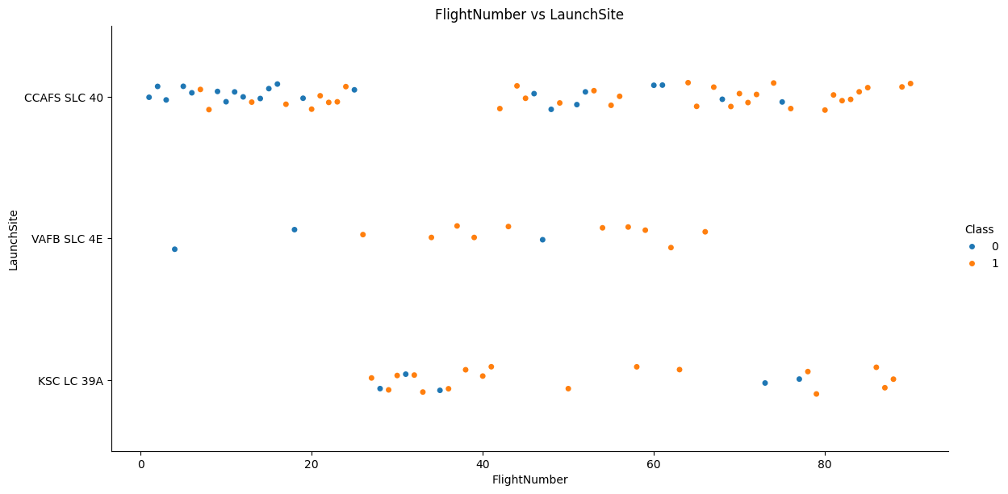
Flight Number vs. Launch Site
From the plot, we found that the larger the flight amount at a launch site, the greater the success rate at a launch site.

Slide 20
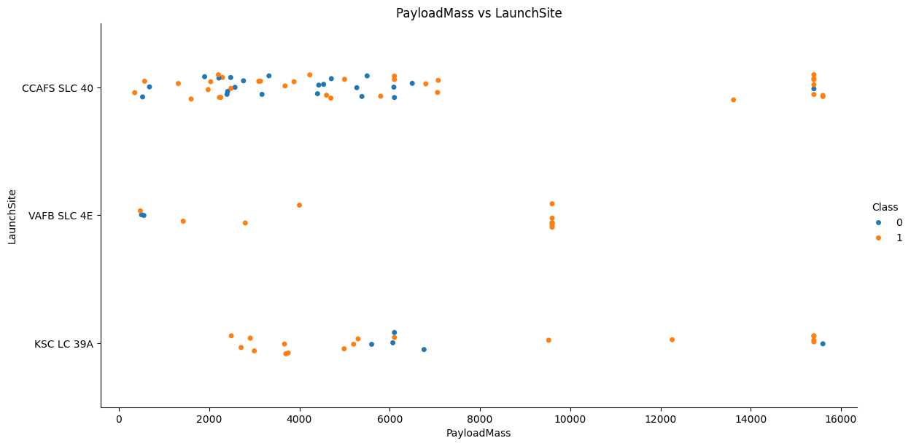
Payload vs. Launch Site
The higher payload mass, the higher successful rate for the rocket

Slide 21
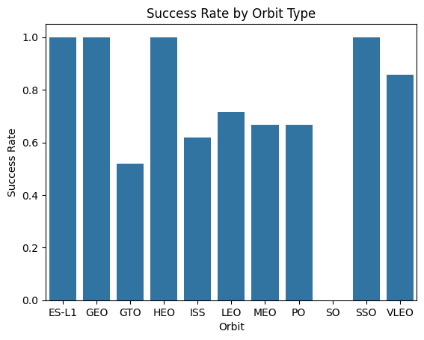
Success Rate vs. Orbit Type
ES-L1, GEO, HEO, SSO, VLEO had the most success rate

Slide 22
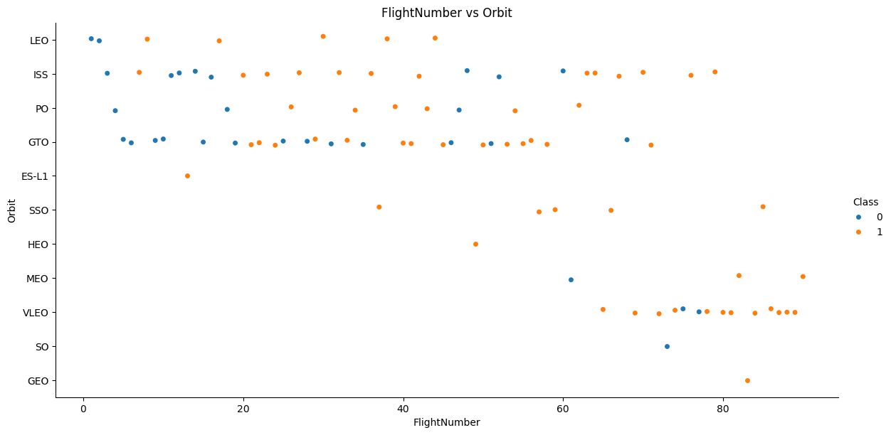
Flight Number vs. Orbit Type
We observe that in the LEO orbit, success is related to the number of flights whereas in the GTO orbit, there is no relationship between flight number and the orbit.

Slide 23
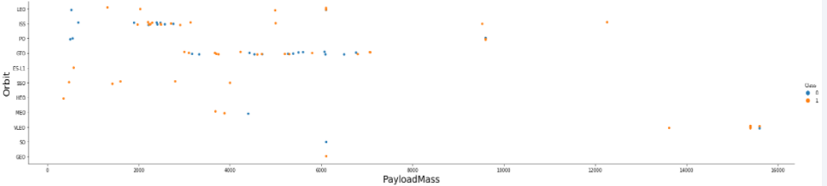
Payload vs. Orbit Type
We can observe that with heavy payloads, the successful landing are more for PO, LEO and ISS orbits.

Slide 24
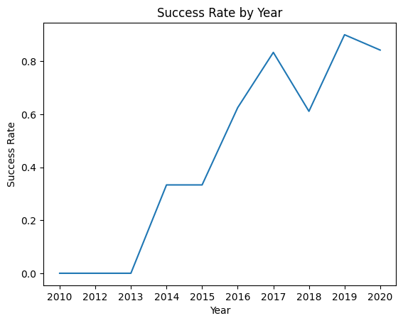
Launch Success Yearly Trend
From the plot, we can observe that success rate since 2013 kept on increasing till 2020.

Slide 25
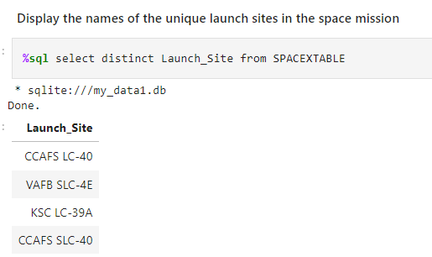
All Launch Site Names
Use DISTINCT to find to unique name of launch site:

Slide 26
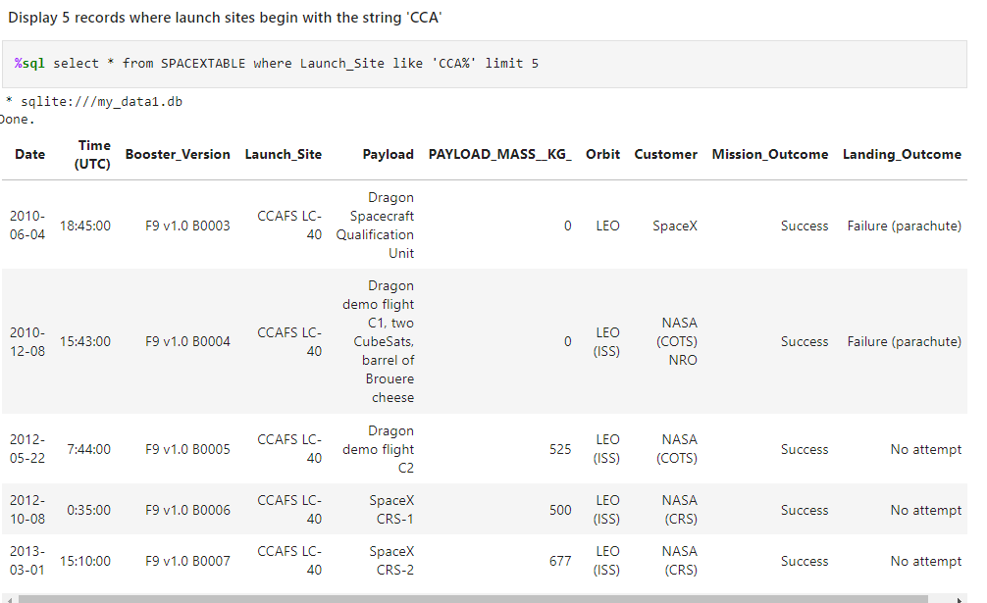
Launch Site Names Begin with 'CCA'
LIMIT 5 records that names begin with ‘CCA’

Slide 27
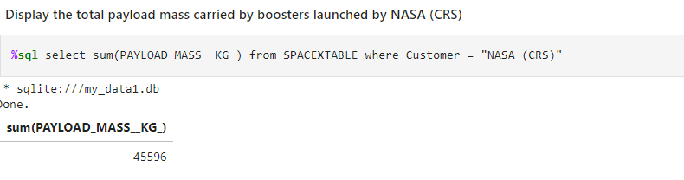
Total Payload Mass
We calculated the total payload carried by boosters from NASA as 45596 using the query below

Slide 28
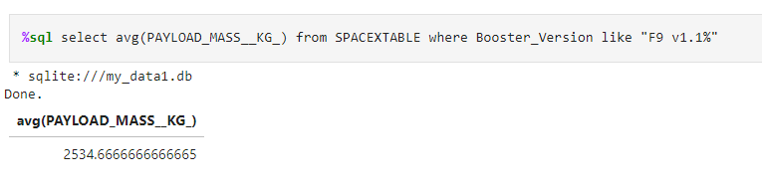
Average Payload Mass by F9 v1.1
We calculated the total payload carried by boosters F9 v1.1 using the query below

Slide 29
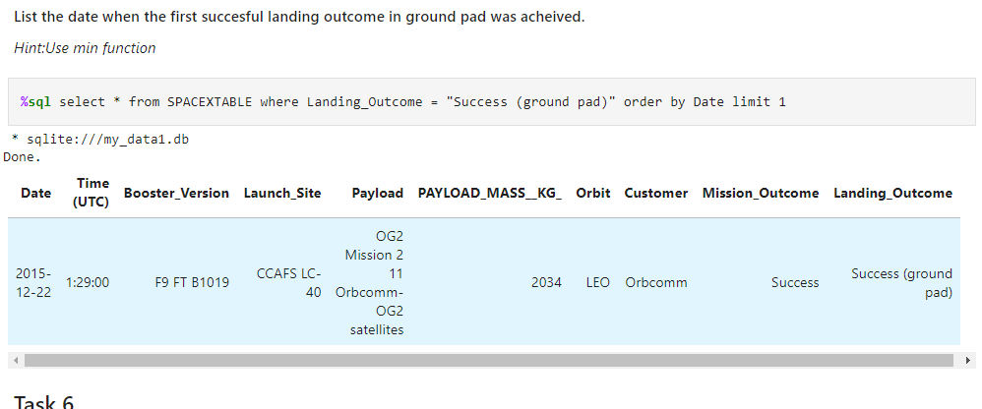
First Successful Ground Landing Date
We observed that the dates of the first successful landing outcome on ground pad was 22nd December 2015

Slide 30
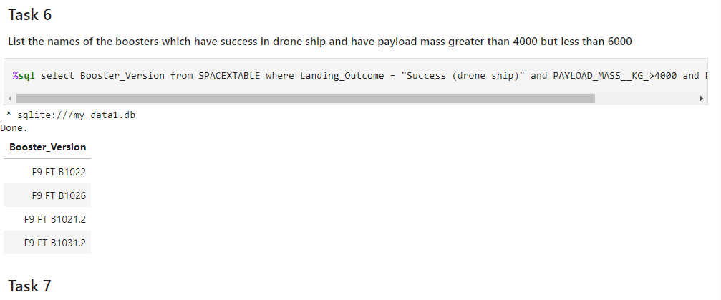
Successful Drone Ship Landing with Payload between 4000 and 6000
We used the WHERE clause to filter for boosters which have successfully landed on drone ship and applied the AND condition to determine successful landing with payload mass greater than 4000 but less than 6000

Slide 31
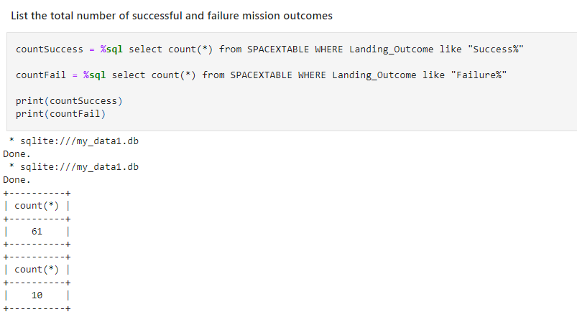
Total Number of Successful and Failure Mission Outcomes
We used wildcard like ‘%’ to filter for WHERE MissionOutcome was a success or a failure.

Slide 32
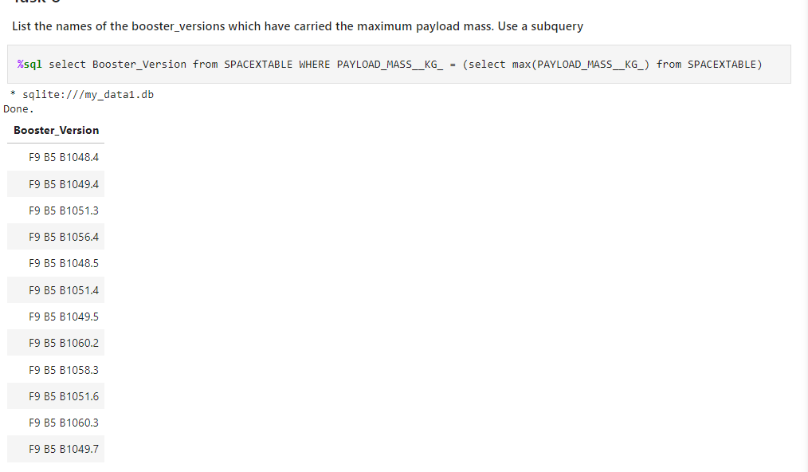
Boosters Carried Maximum Payload
We determined the booster that have carried the maximum payload using a subquery in the WHERE clause and the MAX() function.

Slide 33
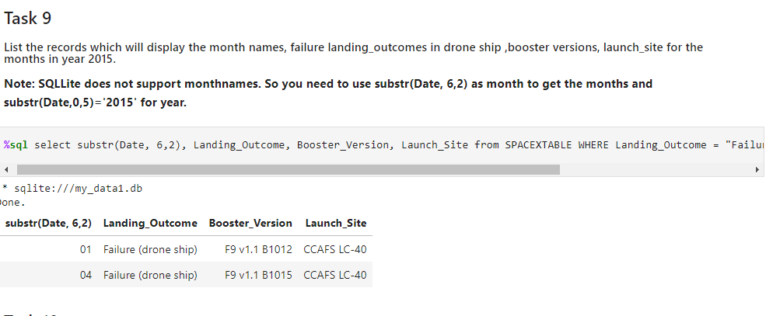
2015 Launch Records
We used a combinations of the WHERE clause, LIKE, AND, and BETWEEN conditions to filter for failed landing outcomes in drone ship, their booster versions, and launch site names for year 2015e

Slide 34
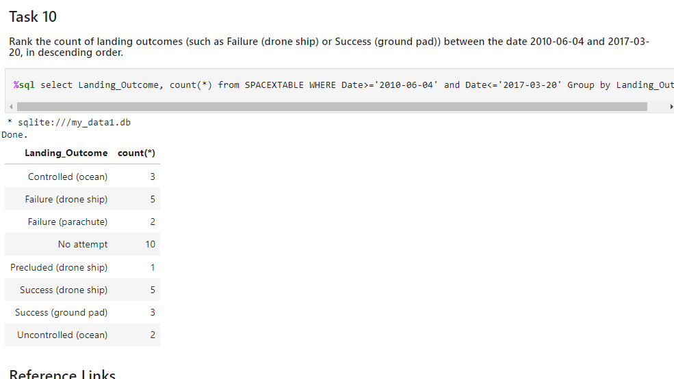
Rank Landing Outcomes Between 2010-06-04 and 2017-03-20
We selected Landing outcomes and the COUNT of landing outcomes from the data and used the WHERE clause to filter for landing outcomes BETWEEN 2010-06-04 to 2010-03-20. • We applied the GROUP BY clause to group the landing outcomes and the ORDER BY clause to order the grouped landing outcome in descending order.

Slide 35

Section 3

Slide 36
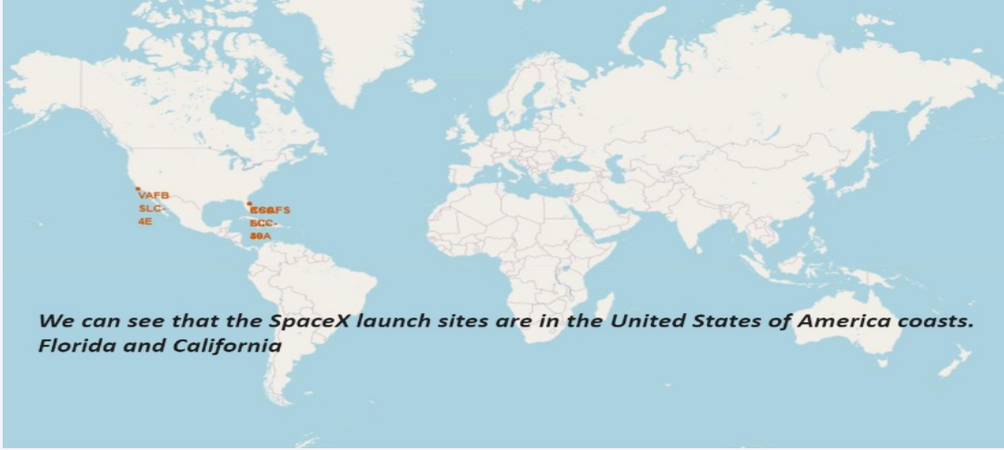
All launch sites global map markers

Slide 37
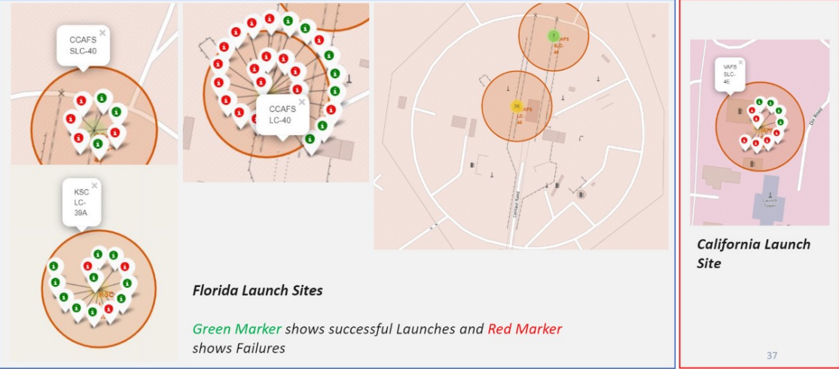
Markers showing launch sites with color labels

Slide 38
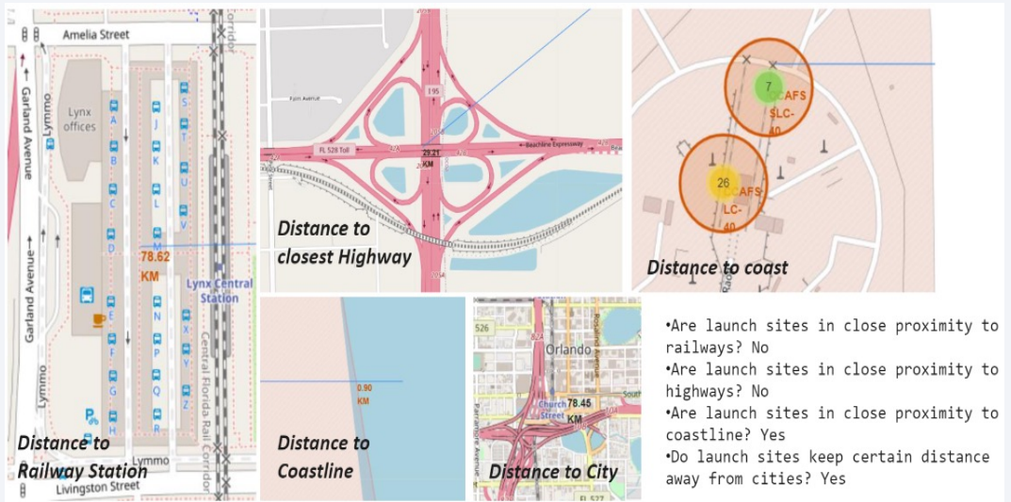
Launch Site distance to landmarks

Slide 39

Section 4

Slide 40
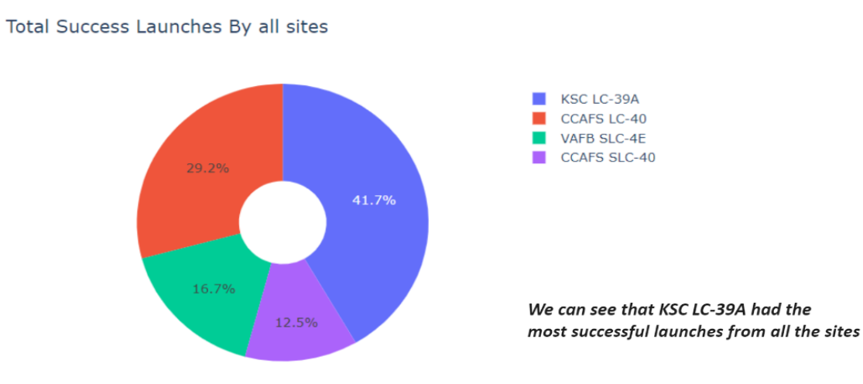
Pie chart showing the success percentage achieved by each launch site

Slide 41

Pie chart showing the Launch site with the highest launch success ratio

Slide 42
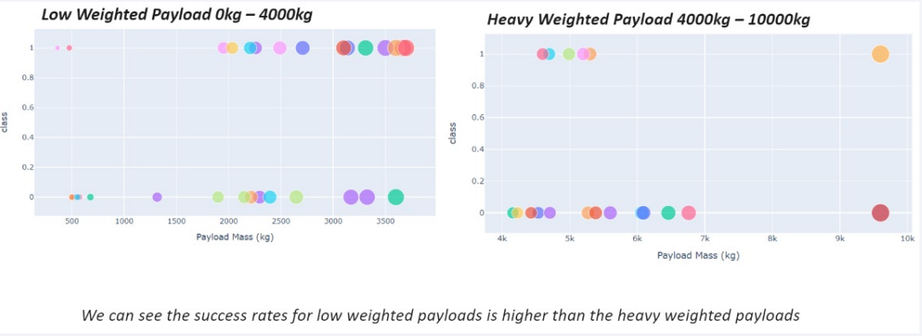
Scatter plot of Payload vs Launch Outcome for all sites, with different payload selected in the range slider

Slide 43

Section 5

Slide 44
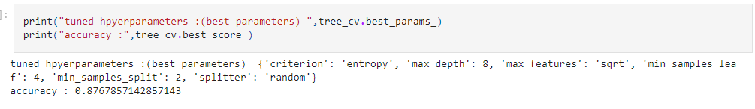
Classification Accuracy
The decision tree classifier is the model with the highest classification accuracy

Slide 45
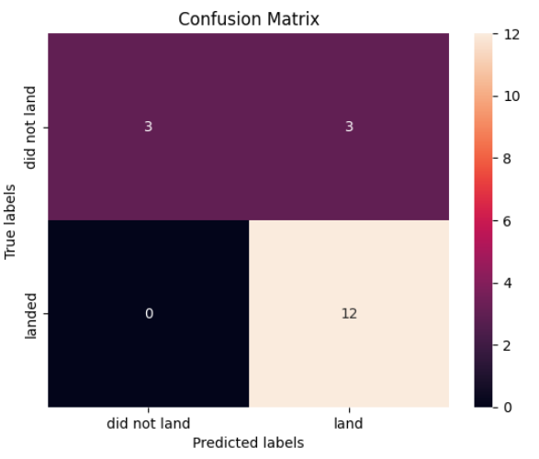
Confusion Matrix
The confusion matrix for the decision tree classifier shows that the classifier can distinguish between the different classes. The major problem is the false positives .i.e., unsuccessful landing marked as successful landing by the classifier.

Slide 46
Conclusions
The larger the flight amount at a launch site, the greater the success rate at a launch site.
Launch success rate started to increase in 2013 till 2020.
Orbits ES-L1, GEO, HEO, SSO, VLEO had the most success rate.
KSC LC-39A had the most successful launches of any sites.
The Decision tree classifier is the best machine learning algorithm for this task.

Slide 47


